Slide 1
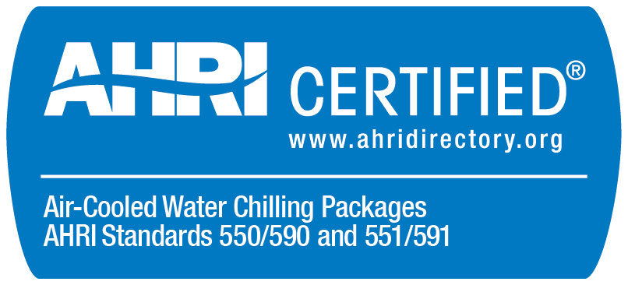
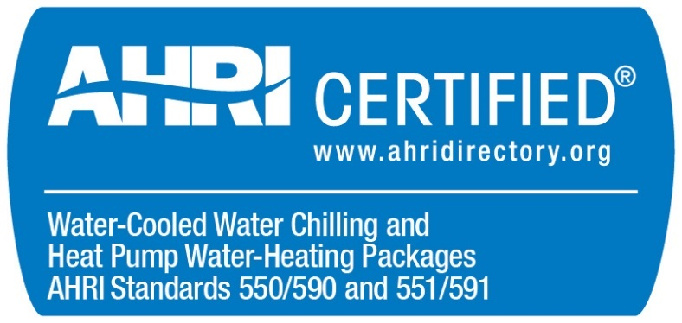
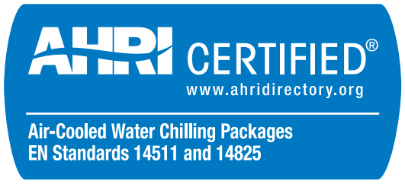
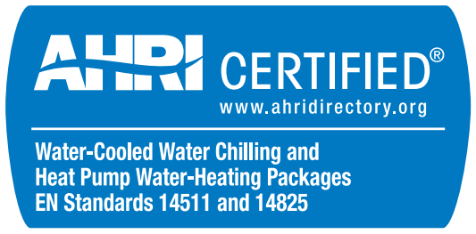
Air-Cooled Chillers (ACCL) and Water-Cooled Chillers (WCCL) Certification Program Update
2021

Slide 2
Updated Sections of the ACCL and WCCL OMs (2021)
Effective May 1, 2021
Require compliance with 2020 versions of AHRI Standards 550/590 (I-P) and 551/591 (SI). All references updated.
Clarify fifth point percent load calculation and re-rate procedure. Added examples in Appendix B (ACCL) or A (WCCL).
Clarify procedure for determination of Maximum Approved Test Stand Capacity.
Penalty tests may be assigned to the same test year as the failed test or the following year, to be determined by AHRI.
Added certification statement flowchart in Appendix C (ACCL) or Appendix B (WCCL).
Compliance Committee to approve Test Stand User testing fees
Minor edits throughout
Updated “Fluid” to “Liquid”
Standardize terminology on “Cooling Capacity”

Slide 3
Updated Sections of the ACCL and WCCL OMs (2021)
Effective December 31, 2021
Updates to certification statements
Revised certification statement for units containing freeze protection.
Selections for units with freeze protection must include performance of the unit rated with water on the same software output report or catalog to claim certification
Clarify statement to be used for application ratings outside the scope of the standard.
WCCL: Selections for heating or heating and cooling must include heating performance at full-load standard rating conditions on the same software output report or catalog to claim certification.
Removed redundant section on Alternate Certification.
Aligned EN Certification Statement between ACCL and WCCL.

Slide 4
Require compliance with 550/590-2020 and 551/591-2020
Why: An extension was previously granted to allow participants to use 550/590-2018 and 551/591-2018 until May 1, 2021. That extension expired, so participants must now use the current 2020 versions.
What: Removed note from preface that had extended required compliance date to May 1, 2021. All references updated to match new versions.
For a summary of changes in the standard please refer to the presentation:
AHRI 550/590 & 551/591 Changes from 2018 with Errata
Notes:
One Participant has re-rated the same BMG for two consecutive years.

Slide 5
Clarify 5th Point Percent Load and Re-Rate
Why: Resolve ambiguity in fifth point percent load calculation and re-rate procedure.
What: Updated sections 3.8.1 and 3.9.3.
AHRI to select a capacity for the 5th point. Clarify that if software requires a separate selection for the 5th point, the selected capacity is the target, not percent load.
Clarify determination of additional test points for 5th point re-rates.
Clarify that re-rate percentage is determined without tolerances.
Allow use of interpolation to determine passing points for re-rate boundary.
Added appendix to include examples for clarity.
Notes:
One Participant has re-rated the same BMG for two consecutive years.

Slide 6
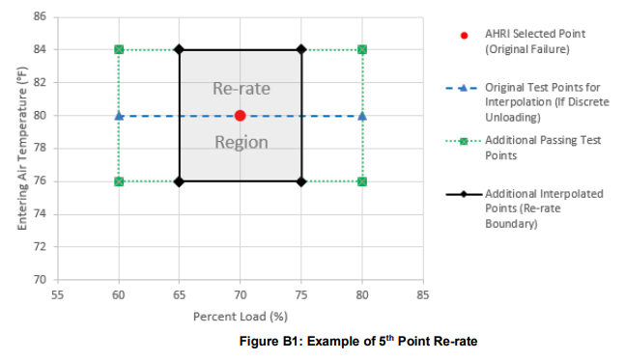
5th Point Re-Rate Example

Slide 7
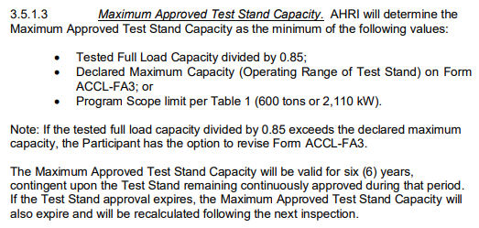
Clarify procedure for determination of Maximum Approved Test Stand Capacity
Why: Provide transparency by aligning language in OM with AHRI’s process.
What:
Notes:
One Participant has re-rated the same BMG for two consecutive years.

Slide 8
Penalty Test
Why: Avoid delays in completing penalty tests.
What: Penalty tests may be assigned to either the same test year as the failed test or the following year.
AHRI will determine the test year depending on when the re-rate occurs.
Notes:
One Participant has re-rated the same BMG for two consecutive years.

Slide 9
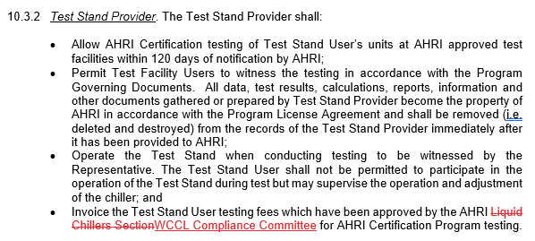
Approval of Test Stand User Testing Fees
Why: Liquid Chillers Section no longer exists.
What: Test Stand User testing fees to be approved by Compliance Committee.
Notes:
One Participant has re-rated the same BMG for two consecutive years.

Slide 10
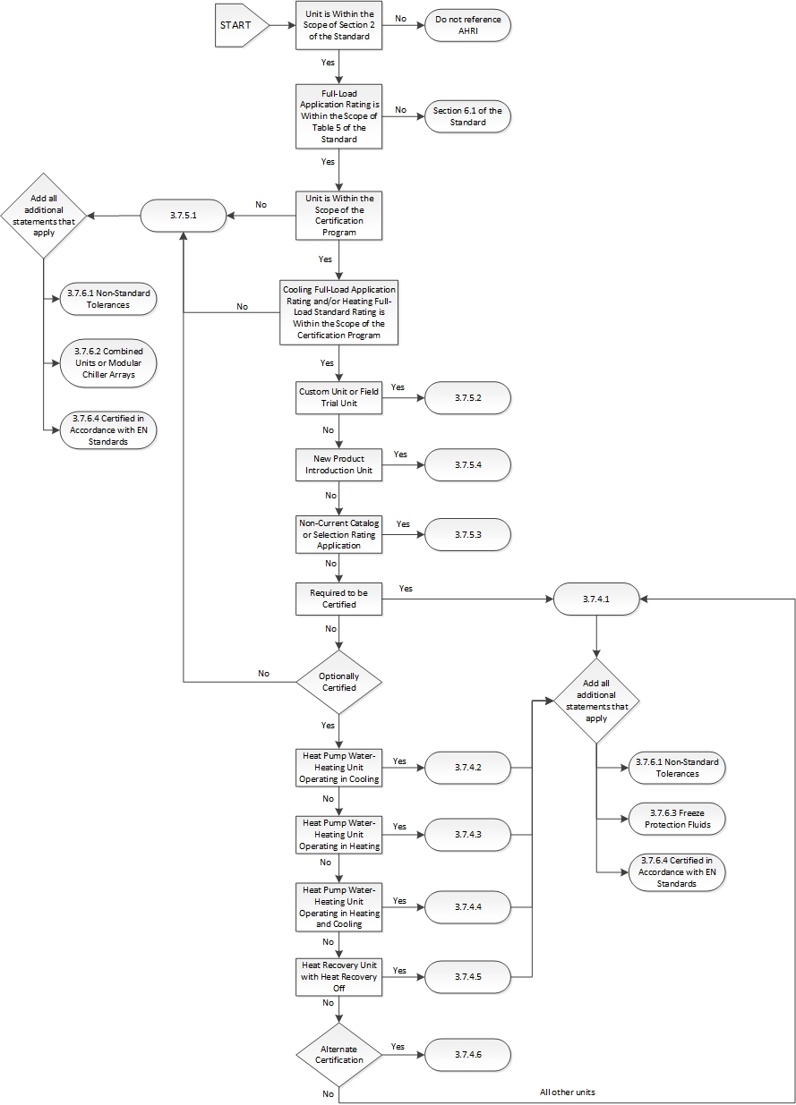
Certification Statement Flowchart
Why: Increased likelihood that participants will see and use the flowchart.
What: Incorporated Certification Statement Flowchart as an appendix to the OMs. Added a reference in section 3.7.4
Flowcharts were previously published on the AHRI website.
WCCL
Flowchart
Notes:
One Participant has re-rated the same BMG for two consecutive years.

Slide 11
Certification Statements: Freeze Protection
Why: Freeze protection ratings are not certified. This change ensures selections for units with freeze protection include certified performance (water only) when claiming certification. Temperature was removed to avoid confusion because selections below 36°F are outside the scope of 550/590.
What:
Notes:
One Participant has re-rated the same BMG for two consecutive years.

Slide 12
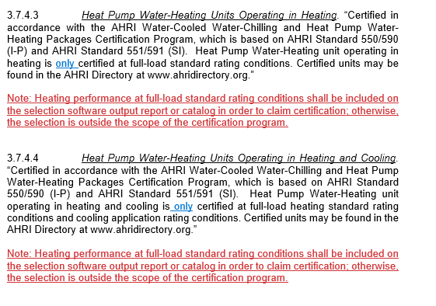
Certification Statements: WCCL Heating Units
Why: Heating performance is certified at full-load standard rating conditions only. This change ensures selections include certified performance when claiming certification.
What:
Notes:
One Participant has re-rated the same BMG for two consecutive years.

Slide 13
Certification Statements: Application Ratings Outside the Scope of the Standard
Why: Clarify what statement should be used when application ratings are outside the scope of the Standard.
What:
Notes:
One Participant has re-rated the same BMG for two consecutive years.

Slide 14
Certification Statements: EN Certification
Why: Update WCCL EN Certification Statement to match ACCL.
What:
Notes:
One Participant has re-rated the same BMG for two consecutive years.

Slide 15
Certification Statements: Alternate Certification
Why: Section was redundant with 3.7.5.1.
What: Removed section 3.7.5.5
Notes:
One Participant has re-rated the same BMG for two consecutive years.

